Slide 1
Autonomous 6 Axis Face Tracking
MAE 6291– Final project presentation
Eliot Hunter, Shota Kakiuchi
Department of Mechanical and Aerospace Engineering

Slide 2
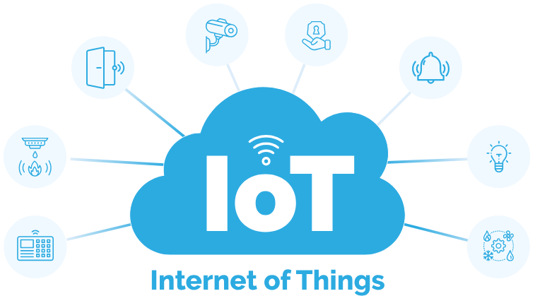



Motivation and Steps Taken
Low Cost, modular, open-source approach for IoT automation and Security
System Prototype and Implementation of Hardware / Python Code
Live Demonstration, and testing for further analysis and future applications

Slide 3
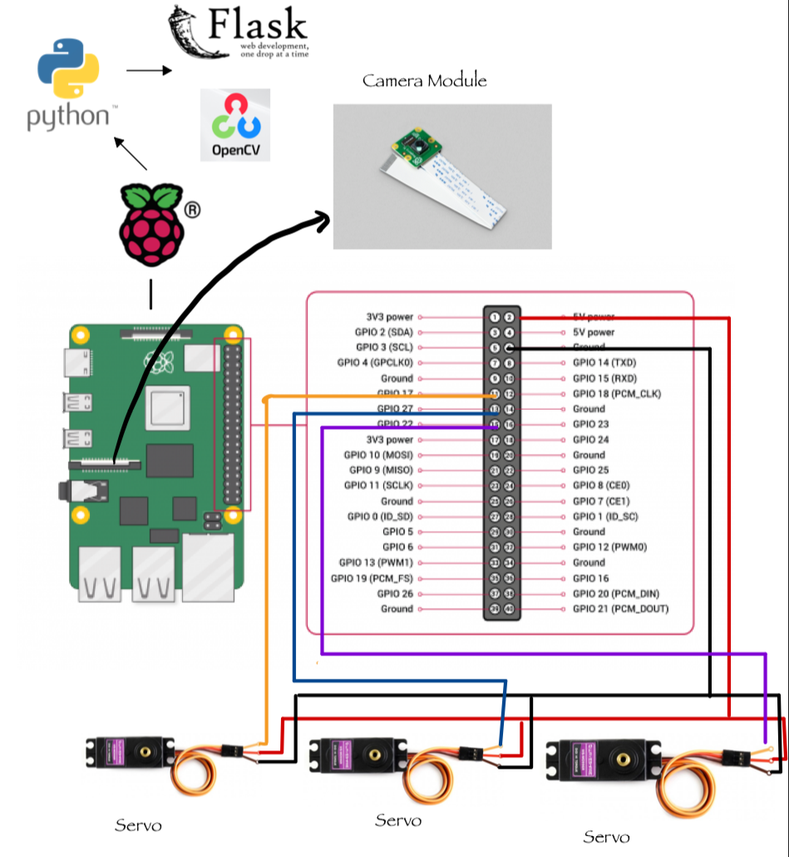
Hardware Integration and Control System
Materials and hardware used:
Raspberry Pi 4 Model B
Python + Flask + OpenCV
Raspberry Pi Camera Module
3x servos
3D Printed Mount
Schematics
Source: Dr. Kartik Bulusu & Amazon

Slide 4
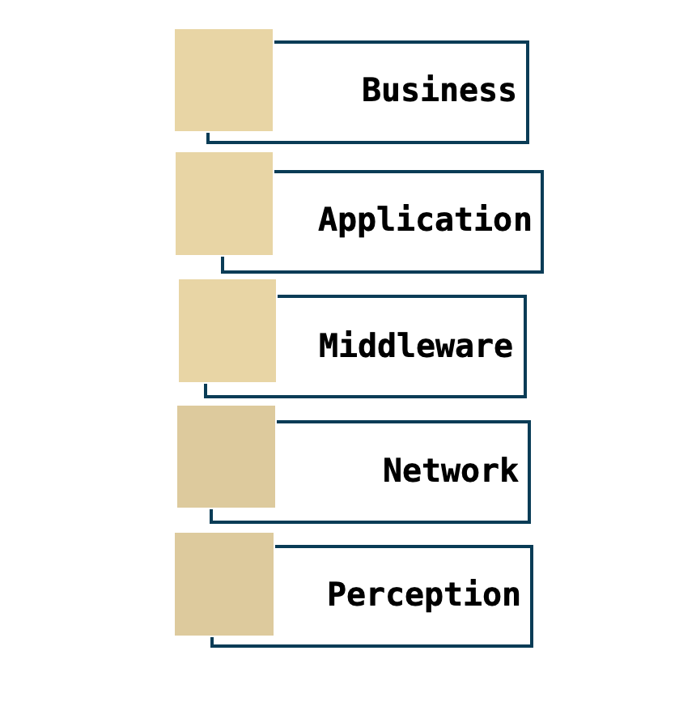



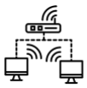
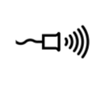
Model Correlation and Connections
Our “thing” - An Autonomous 6 Axis Gimbal with Face Tracking
Completely self contained
Fits within a small housing
Has a computer inside
Has firmware and software
Connects to other things
Computes in real time
System at the edge (processing, tracking, and recognizing faces internally; website hosting)
- Real-time autonomous surveillance
- Security, Telepresence, etc.
- Flask-based server
- Live or updated webpage of latest image display
- OpenCV’s real-time facial recognition
- Servo motor controller (PWM)
- Local Wi-Fi
- HTTP/REST API
- Raspberry Pi Camera Module
- 3x Servos

Slide 5
Conclusions and Moving Forward
Prototype Completion
4/21
In conclusion, we successfully developed a low-cost, modular, and open-source framework for IoT security automation. The device utilizes OpenCV for facial detection and integrates servo mechanisms to enable real-time facial tracking. This technology has a broad range of potential applications and represents a significant contribution to security solutions, particularly in the context of emerging challenges posed by generative AI and deep fakes.
Demonstration & Analysis
4/23
POTENTIAL ADDITIONS
3rd Servo and Self Balancing
Security Use
Display Data on app
LASER

